Slide 1
Practical Deep Learning for Engineers
Dr. Ahmad Al Sallab
Senior Expert

Slide 2
Looking for a Job?

Slide 3
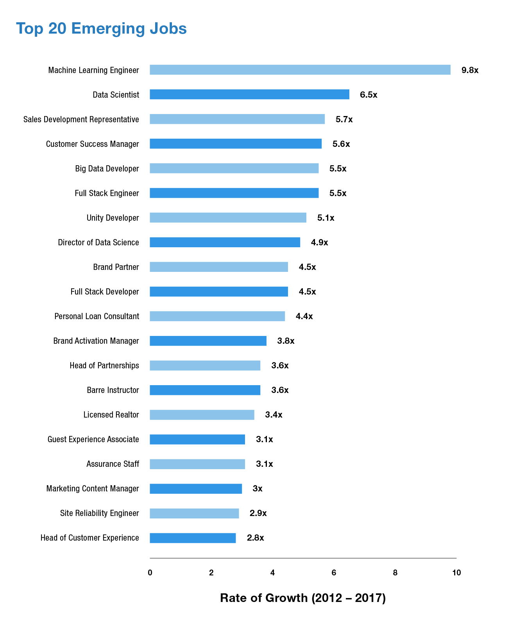

Slide 4
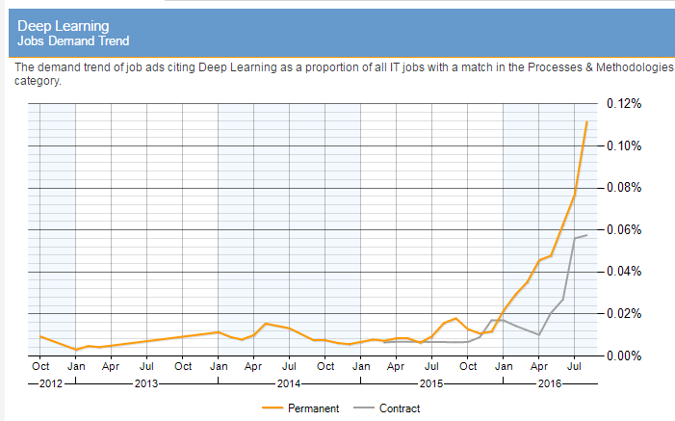
http://www.itjobswatch.co.uk/jobs/uk/deep%20learning.do
Notes:
http://www.itjobswatch.co.uk/jobs/uk/deep%20learning.do

Slide 5
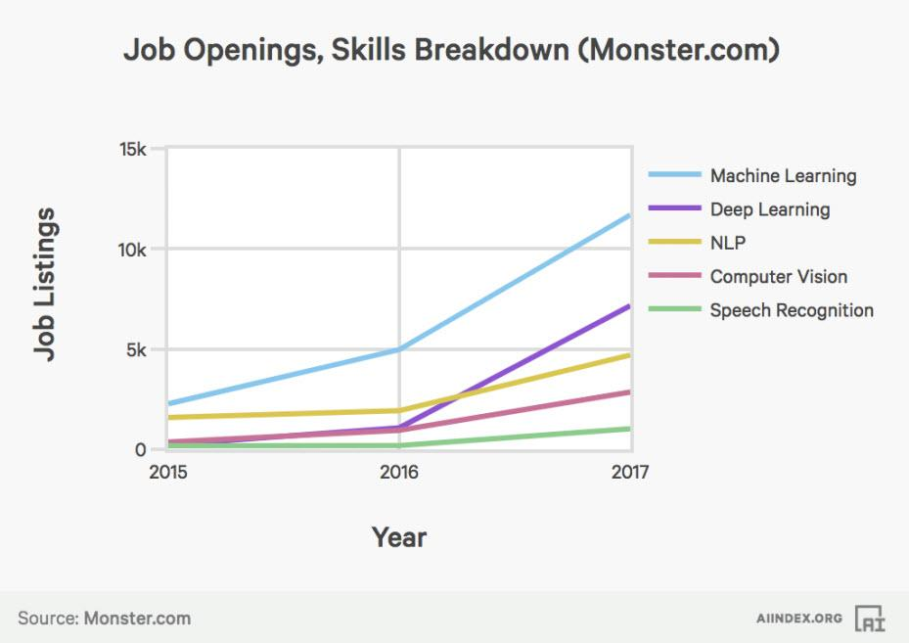
Notes:
http://www.itjobswatch.co.uk/jobs/uk/deep%20learning.do

Slide 6
Run your own business?

Slide 7
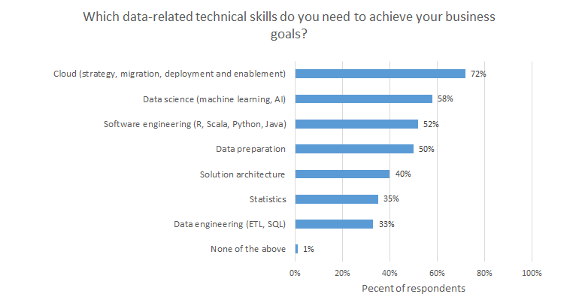
https://www.zdnet.com/article/it-jobs-in-2020-preparing-for-the-next-industrial-revolution/

Slide 8
Want to advance technology?

Slide 9
Self driving cars – Dream!
MIT Review 2013: Driverless Cars Are Further Away Than You Think
MIT’s Leonard, for one, does not believe total autonomy is imminent. “I do not expect there to be taxis in Manhattan with no drivers in my lifetime,” he said

Slide 10
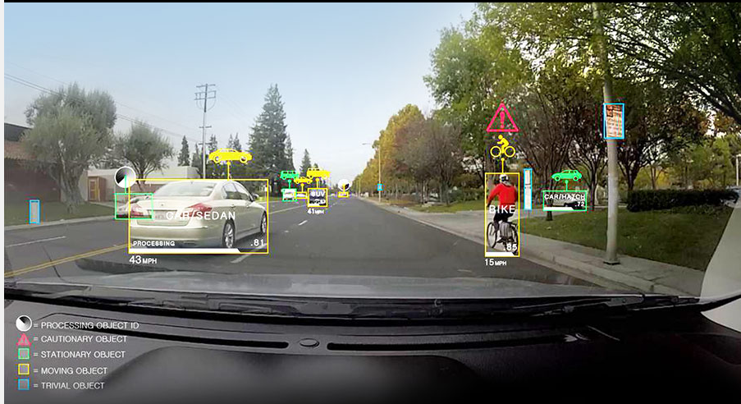
Deep Learning in Autonomous driving 2015
CES 2015: Audi and Nvidia Demos a Car Computer Trained with “Deep Learning”

Slide 11
Deep Learning is here for Rescue: Turning point
MIT Review 2013: Driverless Cars Are Further Away Than You Think
MIT’s Leonard, for one, does not believe total autonomy is imminent. “I do not expect there to be taxis in Manhattan with no drivers in my lifetime,” he said
CES 2015: NVIDIA + Audi: first Deep Learning Autonomous system
CES 2016: NVIDIA demos RL+DL car
Future → Drive-less cabs in Tokyo Olympic games 2020!

Slide 12

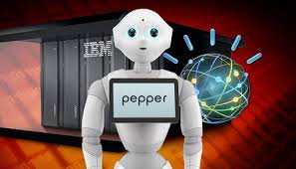
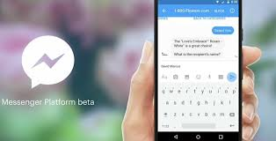
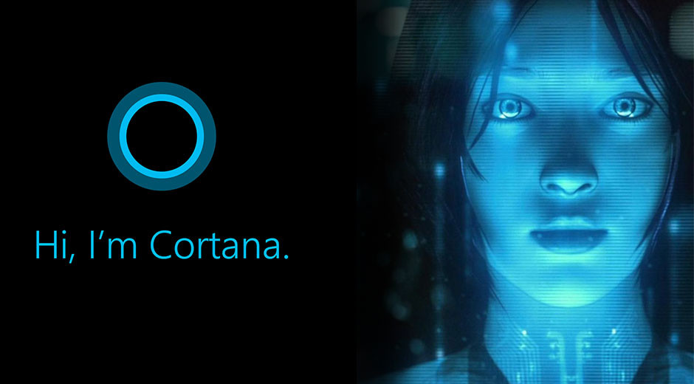
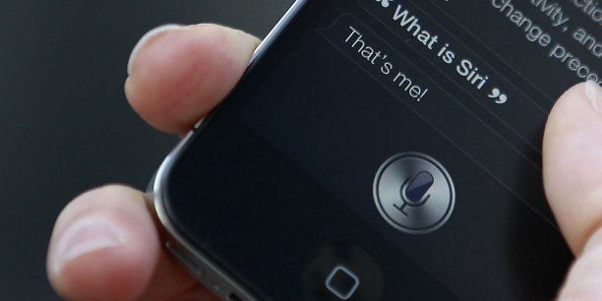
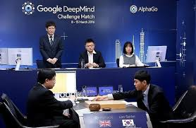
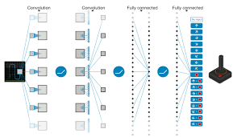
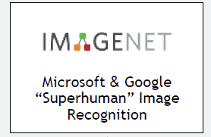
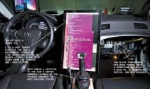
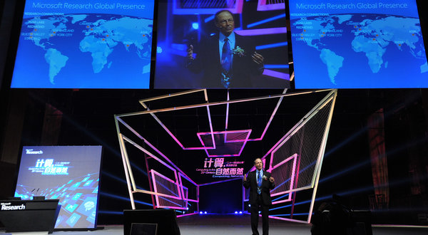
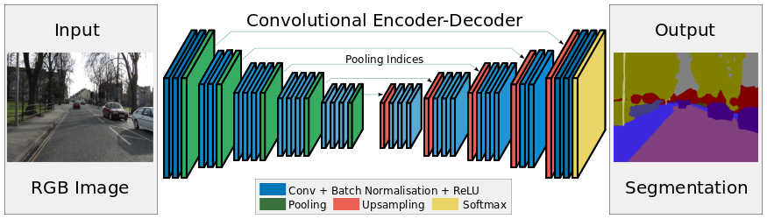
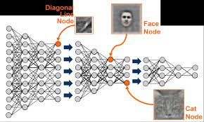
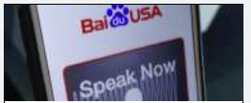
The AI revolution – 2015/2016
Robotics/Control
NLP
Speech
Image
Video
FB Chatbot
IBM Pepper
MS Cortana
Apple Siri
DeepMind
AlphaGo
Atari
DeepMind
SegNet
MS Speech
Comma.ai
HAD
AlexNet
DeepSpeech 2
Notes:
In almost all AI fields, human level intelligence is almost achieved:
Human level control Atari and AlphaGo
Human Recognition AlexNet and ImageNet
Human dialogue: Siri

Slide 13

Welcome
Ahmad EL-SALLAB
Ph.D. Cairo University, 2010-2014
M.Sc., Cairo University, 2007-2009
Publications and research
20+ publications in ML/DL, Speech, Comp Vision, Robotics, NLP
Research gate profile: Ahmad A. Al Sallab
Valeo, 2008-Now
S. Expert/S. Chief of AI/DL
Intel, 2005-2008
Lecturer (ITI, CUFE, GUC, NTI,…)

Slide 14
Course Objectives
Practice vs. Thoery

Slide 15
Course Strategy
Python
Ipython notebooks
Keras
Google Colab
Kaggle

Slide 16
Course Plan
2hrs, Twice a week
Google Colab
PROJECT!
From Day 1
Slack
Assignments
Kaggle
Notes:
https://www.kaggle.com/competitions?sortBy=grouped&group=general&page=1&pageSize=20
After 2 (start with Kaggle):
https://www.kaggle.com/c/digit-recognizer
After 3:
House prices prediction
Movie reviews classifier
Classifying newswires
Kaggle projects:
Again ?:
https://www.kaggle.com/c/house-prices-advanced-regression-techniques
https://www.kaggle.com/c/movie-review-sentiment-analysis-kernels-only
https://www.kaggle.com/c/dont-overfit-ii
After 6,7:
https://www.kaggle.com/c/airbus-ship-detection
After 6,7,8:
https://www.kaggle.com/c/humpback-whale-identification
https://www.kaggle.com/c/imagenet-object-localization-challenge
https://www.kaggle.com/c/whale-categorization-playground
https://www.kaggle.com/c/google-ai-open-images-object-detection-track

Slide 17
Course Contents
Introduction to AI
Python, numpy and ipython basics (optional)
Mathematical building blocks of neural nets
Getting started with Neural Nets programming with Keras
Fundamentals of machine learning
Introduction to ConvNets
Transfer learning 1: Using ConvNets with small datasets
Transfer learning 2: Using pre-trained ConvNets
Visualizing ConvNets
Single Object Detection
Multi Label Classification
Multiple Objects Detection

Slide 18
References
Ian Goodfellow DeepLearning Book
Fchollet Keras Book, Deep Learning With Python

Slide 19
Lecture 1: What is Deep Learning?
Dr. Ahmad Al Sallab
Senior Expert

Slide 20
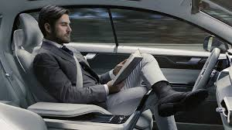
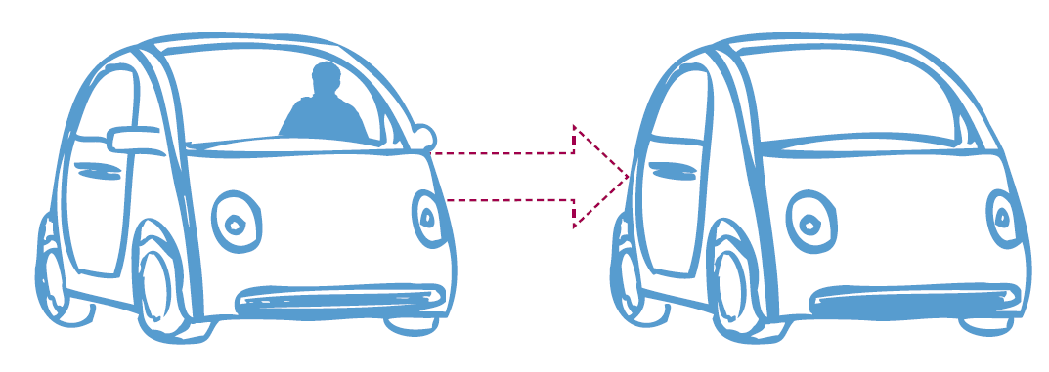
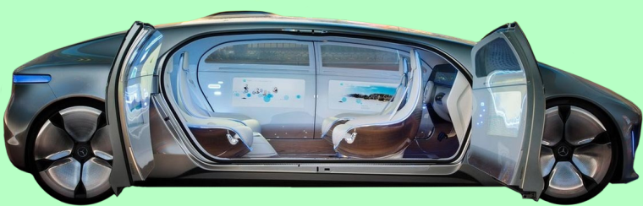
Drive-less Car
How do you imagine a Drive-less Car?

Slide 21
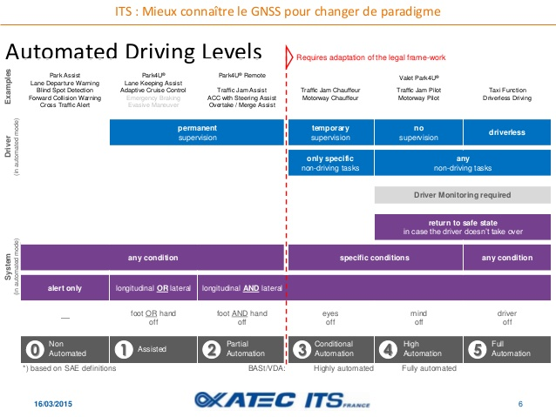
According to driver assistance to fully autonomous – 6 Levels
SAE: Society of Automotive Engineers
Notes:
SAE International, initially established as the Society of Automotive Engineers, is a U.S.-based, globally active professional association and standards developing organization for engineeringprofessionals in various industries. Principal emphasis is placed on transport industries such as automotive, aerospace, and commercial vehicles.

Slide 22
Challenges
Environment Awareness
Recognition
Maps
Environment Infra structure
….
Testing
Legal issues
Decision making
Intelligence → AI

Slide 23
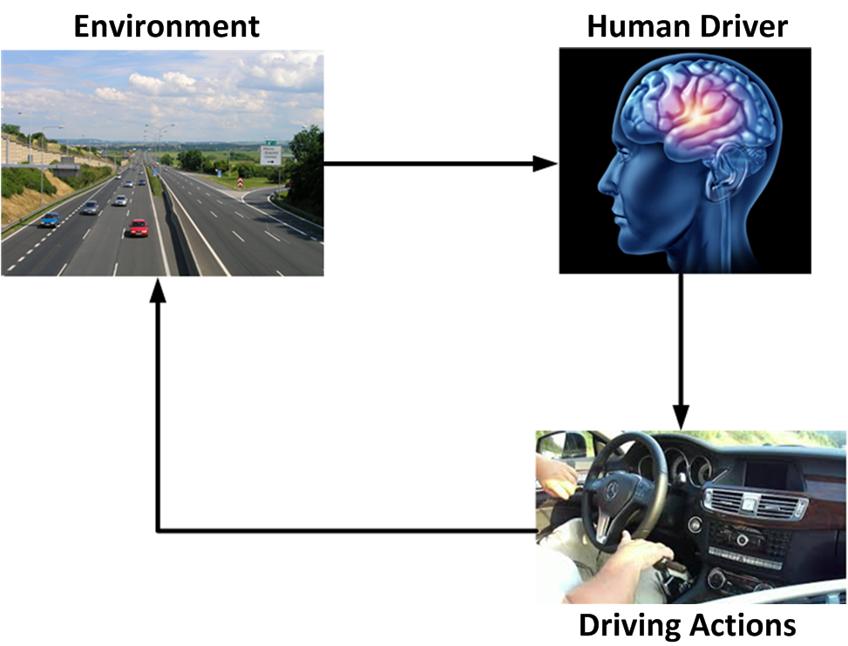
Major challenge: Intelligence

Slide 24
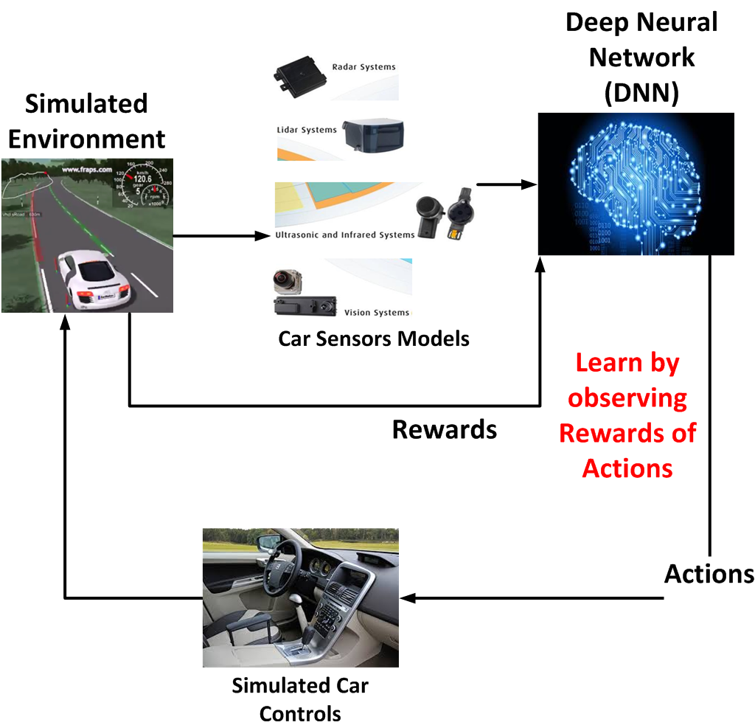
AI Driving cycle

Slide 25
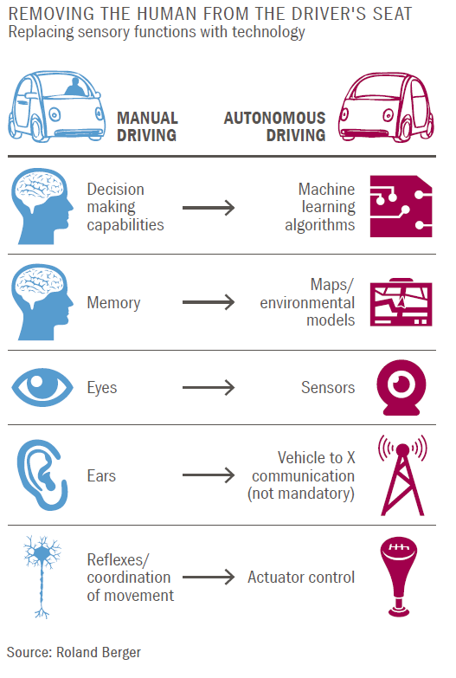
Potential of AI in Autonomous Driving

Slide 26
The AI revolution – 2015/2016
Robotics/Control
NLP
Speech
Image
Video
In almost all AI fields, human level intelligence is almost achieved

Slide 27
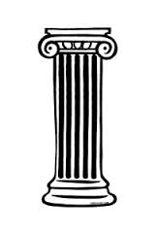
Why now?
Algorithms
Real breakthrough with AlexNet on GPU in 2012
Learn from
Use
Powerful
Hardware
Big Data
Process

Slide 28
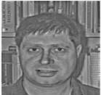
Before DL: AI with Programming
Rules
(If-else)
ID
Rule based AI

Slide 29
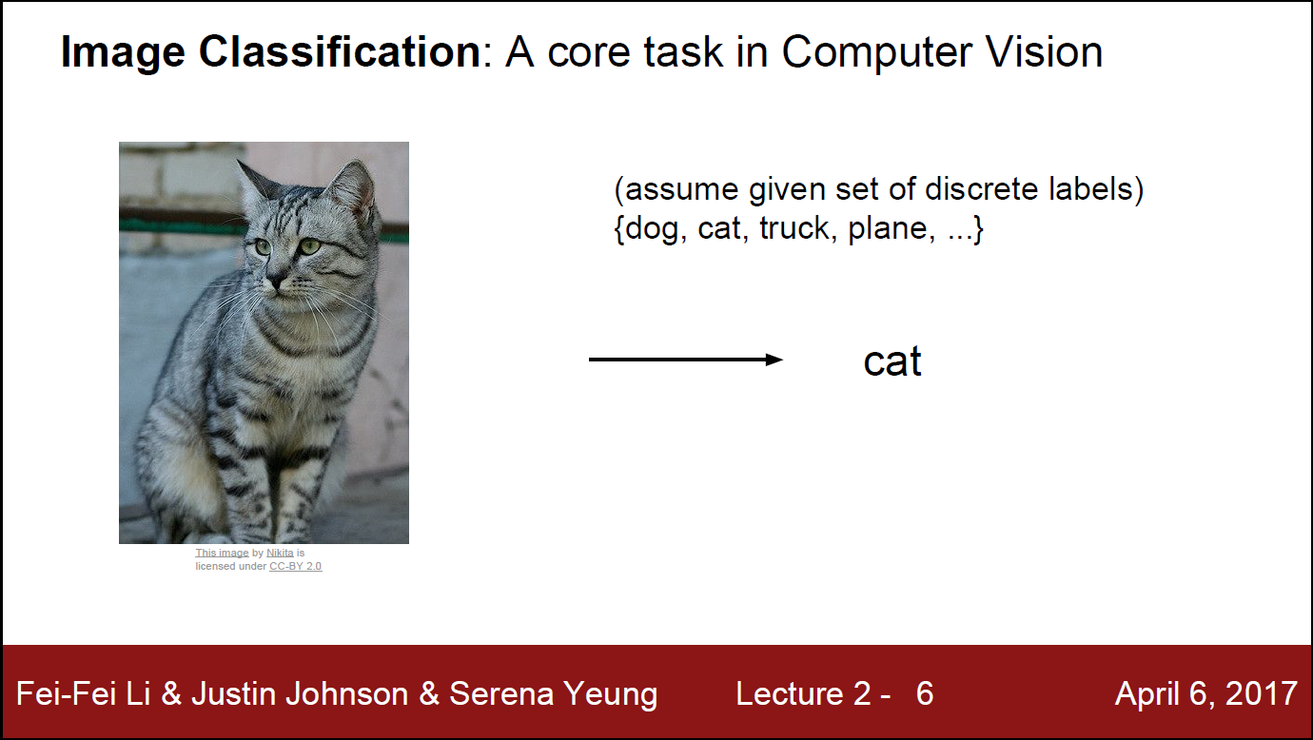

Slide 30
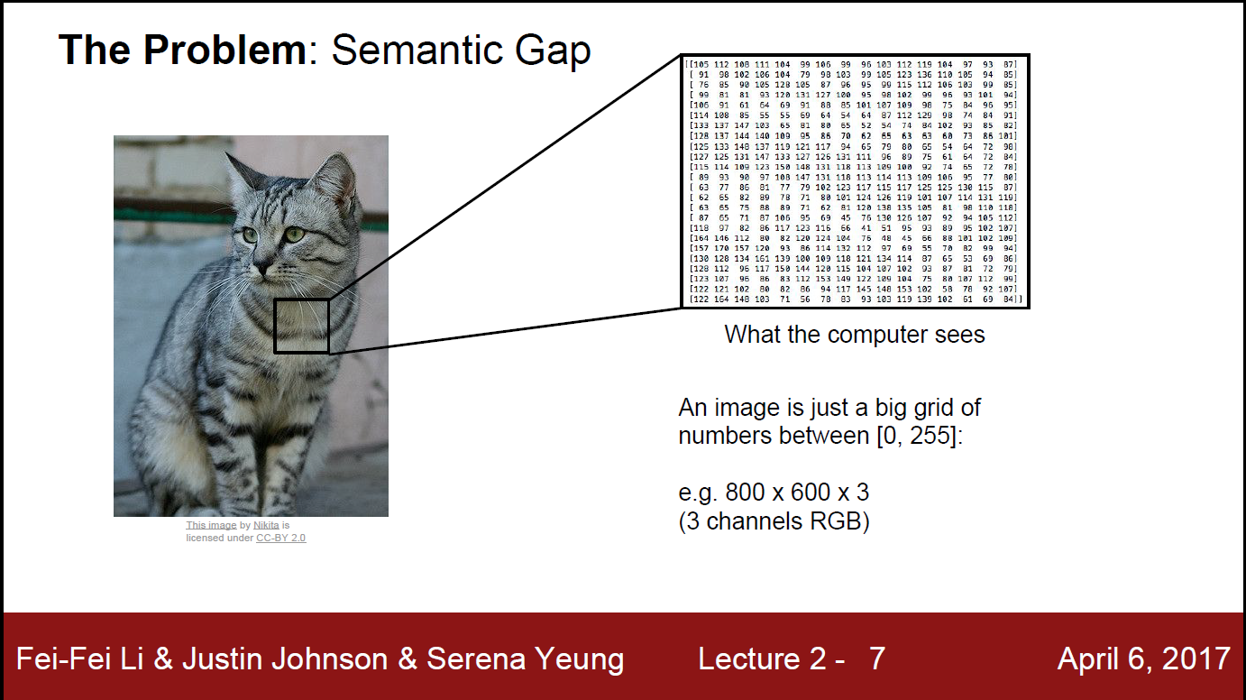

Slide 31
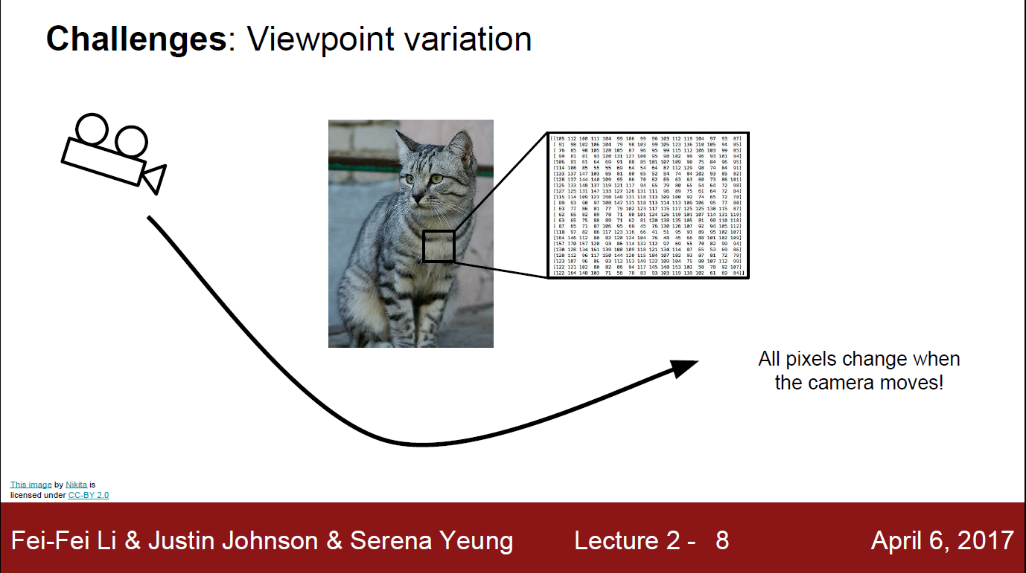

Slide 32
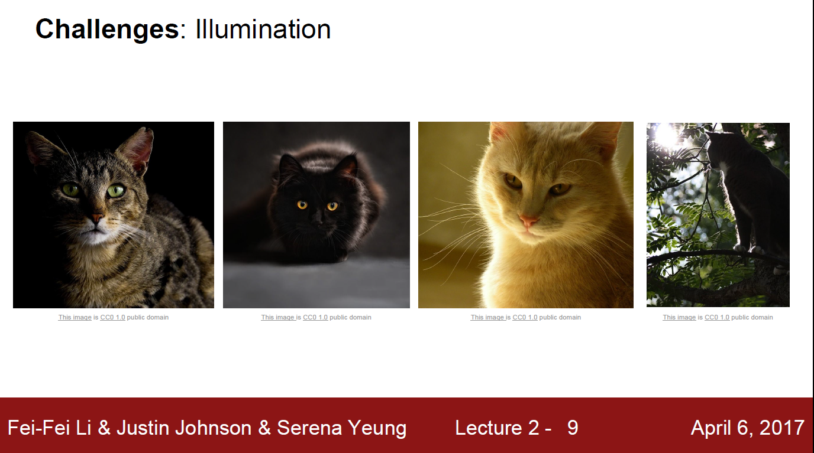

Slide 33
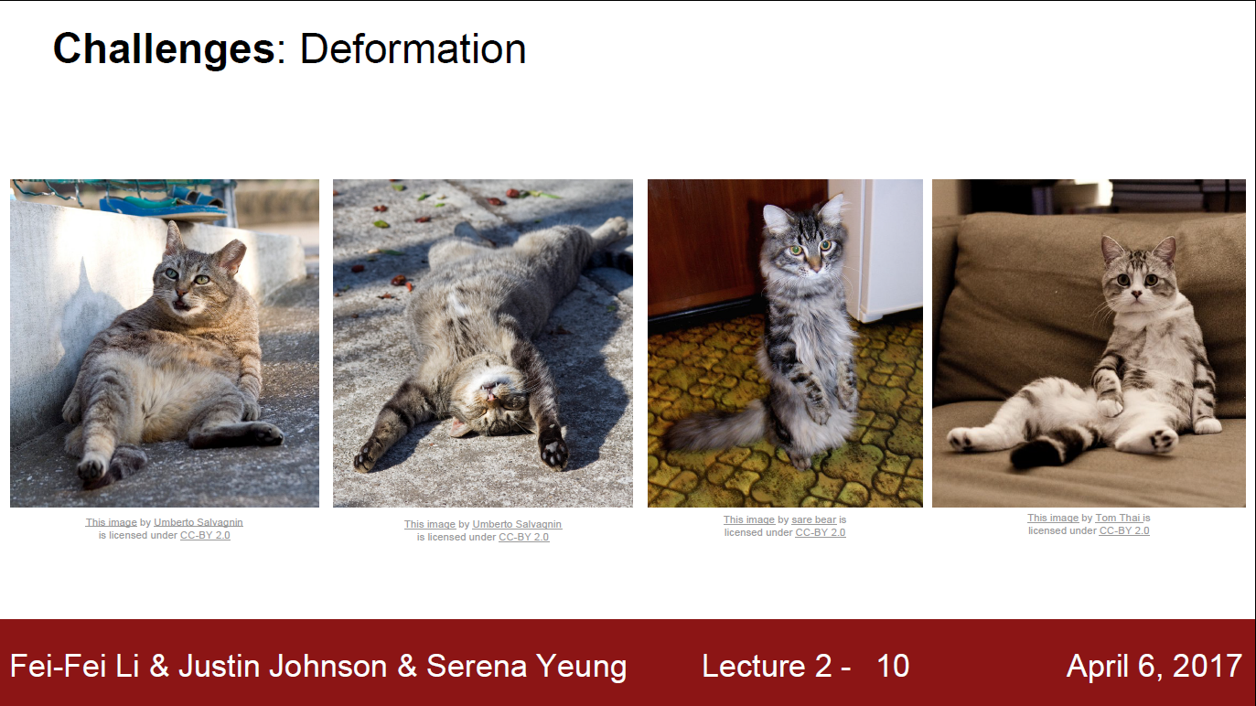

Slide 34
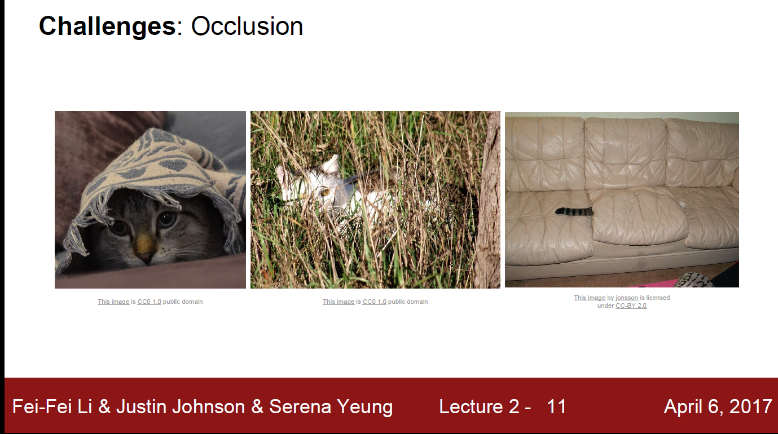

Slide 35
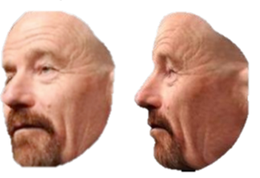
Before DL: AI with Programming
Rules
(If-else)
ID
Did you handle scale?
Did you handle Clutter?
Did you handle colors?
Did you handle pose?

Slide 36
Before DL: AI with Programming
Too many cases!!!!
Rules
(If-else)
ID
Did you handle scale?
Did you handle Clutter?
Did you handle colors?
Did you handle pose?

Slide 37
Before DL: AI with Programming
Let’s learn the rule
Rules
(If-else)
ID

Slide 38
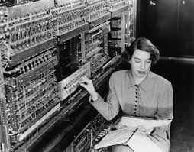
Machine Learning – Why?
Programming
Machine learning
If-else
1945 (ENIAC)
1936 (Turing Machine)
1959 (Arthur Samule)
Problem: clutter, pose, conditions,…etc all affect the designed features vector
1781 (Charles Babbage)
Machine for logical and mathematical computations
Computer
Too many cases!!!
Notes:
Computer
Machine for logical and mathematical computations
1781 (Charles Babbage)
Programming
If-else
1936 (Turing Machine)
1945 (ENIAC)
Machine learning
1959: Arthur Samule: "Field of study that gives computers the ability to learn without being explicitly programmed"
Hand crafted representations/features: Limited HW, Limited Algo, Limited data. Problem: clutter, pose, conditions,…etc all affect the designed features vector
Deep learning
1992 (Hinton Backprop)
2006 (Hinotn DBN, Unsupervised representations)
It’s surpising how the computer was meant to be and how it evolved.
It was meant to mimic human intelligence. But we don’t even understand how our brain achieve its intelligence tasks!
The evolution of traditional if=else prog. Was due to HW limitations + non availability of data
Charles Babbage, an English mechanical engineer and polymath, originated the concept of a programmable computer. Considered the "father of the computer",^{[14]} he conceptualized and invented the first mechanical computer in the early 19th century. After working on his revolutionary difference engine, designed to aid in navigational calculations, in 1833 he realized that a much more general design, an Analytical Engine, was possible. The input of programs and data was to be provided to the machine via punched cards, a method being used at the time to direct mechanical looms such as the Jacquard loom. For output, the machine would have a printer, a curve plotter and a bell. The machine would also be able to punch numbers onto cards to be read in later. The Engine incorporated an arithmetic logic unit, control flow in the form of conditional branching and loops, and integrated memory, making it the first design for a general-purpose computer that could be described in modern terms as Turing-complete.^{[15][16]}
The machine was about a century ahead of its time. All the parts for his machine had to be made by hand — this was a major problem for a device with thousands of parts. Eventually, the project was dissolved with the decision of the British Government to cease funding. Babbage's failure to complete the analytical engine can be chiefly attributed to difficulties not only of politics and financing, but also to his desire to develop an increasingly sophisticated computer and to move ahead faster than anyone else could follow. Nevertheless, his son, Henry Babbage, completed a simplified version of the analytical engine's computing unit (the mill) in 1888. He gave a successful demonstration of its use in computing tables in 1906.
The US-built ENIAC^{[32]} (Electronic Numerical Integrator and Computer) was the first electronic programmable computer built in the US. Although the ENIAC was similar to the Colossus it was much faster and more flexible. Like the Colossus, a "program" on the ENIAC was defined by the states of its patch cables and switches, a far cry from the stored program electronic machines that came later. Once a program was written, it had to be mechanically set into the machine with manual resetting of plugs and switches.
It combined the high speed of electronics with the ability to be programmed for many complex problems. It could add or subtract 5000 times a second, a thousand times faster than any other machine. It also had modules to multiply, divide, and square root. High speed memory was limited to 20 words (about 80 bytes). Built under the direction of John Mauchly and J. Presper Eckert at the University of Pennsylvania, ENIAC's development and construction lasted from 1943 to full operation at the end of 1945. The machine was huge, weighing 30 tons, using 200 kilowatts of electric power and contained over 18,000 vacuum tubes, 1,500 relays, and hundreds of thousands of resistors, capacitors, and inductors.^{[33]}
The principle of the modern computer was proposed by Alan Turing, in his seminal 1936 paper,^{[34]} On Computable Numbers. Turing proposed a simple device that he called "Universal Computing machine" that is later known as a Universal Turing machine. He proved that such machine is capable of computing anything that is computable by executing instructions (program) stored on tape, allowing the machine to be programmable.
Machine learning is a subfield of computer science^{[1]} that evolved from the study of pattern recognition and computational learning theory in artificial intelligence.^{[1]}In 1959, Arthur Samuel defined machine learning as a "Field of study that gives computers the ability to learn without being explicitly programmed".^{[2]}
With ML, the computer was enabled to observe and learn by example→ imitate, but from what? What to look for in the input data? Although the learning algo was good, but due to the lake of good algo to automatically extract features from data, features engineering was presented as a new field in ML. But it’s a kind of mandating how to process the data. This is not the way it goes in our brains.
Also, no one learning algo→ multiple due to features engineering
But how our brain works? No body knows for sure. Just a rough picture: neurons + synapsis (connecting conductors) = Neural Net
How to mimic = ANN: Artifical neurons + Weights (=synapsis). Rough approx. Rough non-linearity.
Deep Learning is here for rescue. ANN were there since 1990’s. But sometimes they work and sometimes not.
Until Geoff. Hinton (the father of ANN also) in 2006 in Toronto invented the DBN → Wave 1.
The idea is to cluster the data, and discover their eigen vectors. Same as Lego building blocks, so it tries to discover those blocks. For each picture in the Lego manual, it is characterized by what are the building blocks (features ) it uses ((extraction)) from the box = features (extraction)
This was followed by another wave of introducing the time factor ➔ composition learning and recurrent NN
This was followed by another wave of higher level intelligence → DL + RL

Slide 39
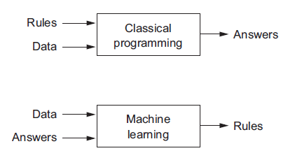
Rule based AI vs. Machine Learning AI
Machine learning is the science of getting computers to act without being explicitly programmed
Notes:
Computer
Machine for logical and mathematical computations
1781 (Charles Babbage)
Programming
If-else
1936 (Turing Machine)
1945 (ENIAC)
Machine learning
1959: Arthur Samule: "Field of study that gives computers the ability to learn without being explicitly programmed"
Hand crafted representations/features: Limited HW, Limited Algo, Limited data. Problem: clutter, pose, conditions,…etc all affect the designed features vector
Deep learning
1992 (Hinton Backprop)
2006 (Hinotn DBN, Unsupervised representations)
It’s surpising how the computer was meant to be and how it evolved.
It was meant to mimic human intelligence. But we don’t even understand how our brain achieve its intelligence tasks!
The evolution of traditional if=else prog. Was due to HW limitations + non availability of data
Charles Babbage, an English mechanical engineer and polymath, originated the concept of a programmable computer. Considered the "father of the computer",^{[14]} he conceptualized and invented the first mechanical computer in the early 19th century. After working on his revolutionary difference engine, designed to aid in navigational calculations, in 1833 he realized that a much more general design, an Analytical Engine, was possible. The input of programs and data was to be provided to the machine via punched cards, a method being used at the time to direct mechanical looms such as the Jacquard loom. For output, the machine would have a printer, a curve plotter and a bell. The machine would also be able to punch numbers onto cards to be read in later. The Engine incorporated an arithmetic logic unit, control flow in the form of conditional branching and loops, and integrated memory, making it the first design for a general-purpose computer that could be described in modern terms as Turing-complete.^{[15][16]}
The machine was about a century ahead of its time. All the parts for his machine had to be made by hand — this was a major problem for a device with thousands of parts. Eventually, the project was dissolved with the decision of the British Government to cease funding. Babbage's failure to complete the analytical engine can be chiefly attributed to difficulties not only of politics and financing, but also to his desire to develop an increasingly sophisticated computer and to move ahead faster than anyone else could follow. Nevertheless, his son, Henry Babbage, completed a simplified version of the analytical engine's computing unit (the mill) in 1888. He gave a successful demonstration of its use in computing tables in 1906.
The US-built ENIAC^{[32]} (Electronic Numerical Integrator and Computer) was the first electronic programmable computer built in the US. Although the ENIAC was similar to the Colossus it was much faster and more flexible. Like the Colossus, a "program" on the ENIAC was defined by the states of its patch cables and switches, a far cry from the stored program electronic machines that came later. Once a program was written, it had to be mechanically set into the machine with manual resetting of plugs and switches.
It combined the high speed of electronics with the ability to be programmed for many complex problems. It could add or subtract 5000 times a second, a thousand times faster than any other machine. It also had modules to multiply, divide, and square root. High speed memory was limited to 20 words (about 80 bytes). Built under the direction of John Mauchly and J. Presper Eckert at the University of Pennsylvania, ENIAC's development and construction lasted from 1943 to full operation at the end of 1945. The machine was huge, weighing 30 tons, using 200 kilowatts of electric power and contained over 18,000 vacuum tubes, 1,500 relays, and hundreds of thousands of resistors, capacitors, and inductors.^{[33]}
The principle of the modern computer was proposed by Alan Turing, in his seminal 1936 paper,^{[34]} On Computable Numbers. Turing proposed a simple device that he called "Universal Computing machine" that is later known as a Universal Turing machine. He proved that such machine is capable of computing anything that is computable by executing instructions (program) stored on tape, allowing the machine to be programmable.
Machine learning is a subfield of computer science^{[1]} that evolved from the study of pattern recognition and computational learning theory in artificial intelligence.^{[1]}In 1959, Arthur Samuel defined machine learning as a "Field of study that gives computers the ability to learn without being explicitly programmed".^{[2]}
With ML, the computer was enabled to observe and learn by example→ imitate, but from what? What to look for in the input data? Although the learning algo was good, but due to the lake of good algo to automatically extract features from data, features engineering was presented as a new field in ML. But it’s a kind of mandating how to process the data. This is not the way it goes in our brains.
Also, no one learning algo→ multiple due to features engineering
But how our brain works? No body knows for sure. Just a rough picture: neurons + synapsis (connecting conductors) = Neural Net
How to mimic = ANN: Artifical neurons + Weights (=synapsis). Rough approx. Rough non-linearity.
Deep Learning is here for rescue. ANN were there since 1990’s. But sometimes they work and sometimes not.
Until Geoff. Hinton (the father of ANN also) in 2006 in Toronto invented the DBN → Wave 1.
The idea is to cluster the data, and discover their eigen vectors. Same as Lego building blocks, so it tries to discover those blocks. For each picture in the Lego manual, it is characterized by what are the building blocks (features ) it uses ((extraction)) from the box = features (extraction)
This was followed by another wave of introducing the time factor ➔ composition learning and recurrent NN
This was followed by another wave of higher level intelligence → DL + RL

Slide 40
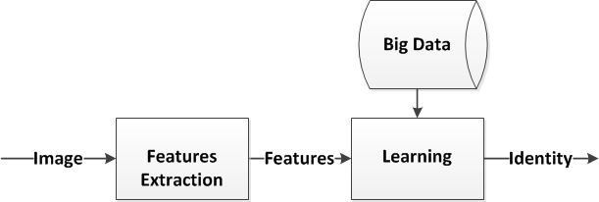
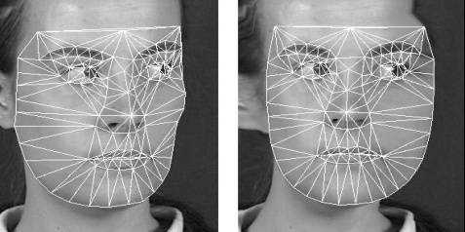
Traditional Machine Learning Pipeline

Slide 41
Features Engineering
Features = f(Raw data)
Raw data = pixels
Features = face points
Feature is a representation / transformation of raw data

Slide 42
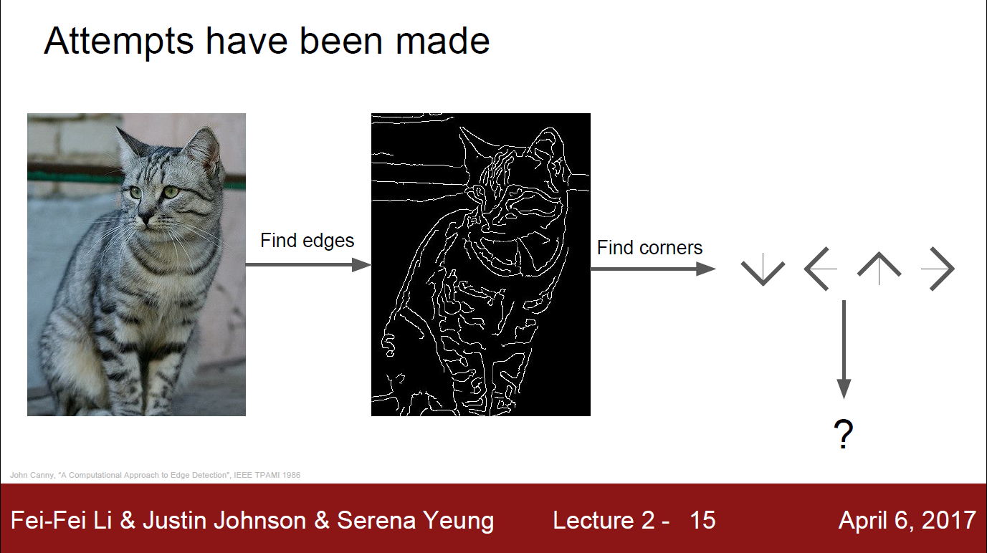

Slide 43
Features Engineering
Again too many cases!
Features = f(Raw data)
Raw data = pixels
Features = face points
Problem: clutter, pose, conditions,…etc all affect the designed features vector

Slide 44
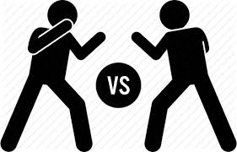
Features = Representations
Let’s learn the features!
Features Engineering
vs.
Representations Learning

Slide 45
Deep Learning – Why?
Programming
Machine learning
`
Deep learning
If-else
Hand crafted representations/features engineering
2006 (Hinotn DBN)
1945 (ENIAC)
1936 (Turing Machine)
1992 (Hinton Backprop)
1959 (Arthur Samule)
Problem: clutter, pose, conditions,…etc all affect the designed features vector
Learning representations/features
1781 (Charles Babbage)
Machine for logical and mathematical computations
Computer
Notes:
Computer
Machine for logical and mathematical computations
1781 (Charles Babbage)
Programming
If-else
1936 (Turing Machine)
1945 (ENIAC)
Machine learning
1959: Arthur Samule: "Field of study that gives computers the ability to learn without being explicitly programmed"
Hand crafted representations/features: Limited HW, Limited Algo, Limited data. Problem: clutter, pose, conditions,…etc all affect the designed features vector
Deep learning
1992 (Hinton Backprop)
2006 (Hinotn DBN, Unsupervised representations)
It’s surpising how the computer was meant to be and how it evolved.
It was meant to mimic human intelligence. But we don’t even understand how our brain achieve its intelligence tasks!
The evolution of traditional if=else prog. Was due to HW limitations + non availability of data
Charles Babbage, an English mechanical engineer and polymath, originated the concept of a programmable computer. Considered the "father of the computer",^{[14]} he conceptualized and invented the first mechanical computer in the early 19th century. After working on his revolutionary difference engine, designed to aid in navigational calculations, in 1833 he realized that a much more general design, an Analytical Engine, was possible. The input of programs and data was to be provided to the machine via punched cards, a method being used at the time to direct mechanical looms such as the Jacquard loom. For output, the machine would have a printer, a curve plotter and a bell. The machine would also be able to punch numbers onto cards to be read in later. The Engine incorporated an arithmetic logic unit, control flow in the form of conditional branching and loops, and integrated memory, making it the first design for a general-purpose computer that could be described in modern terms as Turing-complete.^{[15][16]}
The machine was about a century ahead of its time. All the parts for his machine had to be made by hand — this was a major problem for a device with thousands of parts. Eventually, the project was dissolved with the decision of the British Government to cease funding. Babbage's failure to complete the analytical engine can be chiefly attributed to difficulties not only of politics and financing, but also to his desire to develop an increasingly sophisticated computer and to move ahead faster than anyone else could follow. Nevertheless, his son, Henry Babbage, completed a simplified version of the analytical engine's computing unit (the mill) in 1888. He gave a successful demonstration of its use in computing tables in 1906.
The US-built ENIAC^{[32]} (Electronic Numerical Integrator and Computer) was the first electronic programmable computer built in the US. Although the ENIAC was similar to the Colossus it was much faster and more flexible. Like the Colossus, a "program" on the ENIAC was defined by the states of its patch cables and switches, a far cry from the stored program electronic machines that came later. Once a program was written, it had to be mechanically set into the machine with manual resetting of plugs and switches.
It combined the high speed of electronics with the ability to be programmed for many complex problems. It could add or subtract 5000 times a second, a thousand times faster than any other machine. It also had modules to multiply, divide, and square root. High speed memory was limited to 20 words (about 80 bytes). Built under the direction of John Mauchly and J. Presper Eckert at the University of Pennsylvania, ENIAC's development and construction lasted from 1943 to full operation at the end of 1945. The machine was huge, weighing 30 tons, using 200 kilowatts of electric power and contained over 18,000 vacuum tubes, 1,500 relays, and hundreds of thousands of resistors, capacitors, and inductors.^{[33]}
The principle of the modern computer was proposed by Alan Turing, in his seminal 1936 paper,^{[34]} On Computable Numbers. Turing proposed a simple device that he called "Universal Computing machine" that is later known as a Universal Turing machine. He proved that such machine is capable of computing anything that is computable by executing instructions (program) stored on tape, allowing the machine to be programmable.
Machine learning is a subfield of computer science^{[1]} that evolved from the study of pattern recognition and computational learning theory in artificial intelligence.^{[1]}In 1959, Arthur Samuel defined machine learning as a "Field of study that gives computers the ability to learn without being explicitly programmed".^{[2]}
With ML, the computer was enabled to observe and learn by example→ imitate, but from what? What to look for in the input data? Although the learning algo was good, but due to the lake of good algo to automatically extract features from data, features engineering was presented as a new field in ML. But it’s a kind of mandating how to process the data. This is not the way it goes in our brains.
Also, no one learning algo→ multiple due to features engineering
But how our brain works? No body knows for sure. Just a rough picture: neurons + synapsis (connecting conductors) = Neural Net
How to mimic = ANN: Artifical neurons + Weights (=synapsis). Rough approx. Rough non-linearity.
Deep Learning is here for rescue. ANN were there since 1990’s. But sometimes they work and sometimes not.
Until Geoff. Hinton (the father of ANN also) in 2006 in Toronto invented the DBN → Wave 1.
The idea is to cluster the data, and discover their eigen vectors. Same as Lego building blocks, so it tries to discover those blocks. For each picture in the Lego manual, it is characterized by what are the building blocks (features ) it uses ((extraction)) from the box = features (extraction)
This was followed by another wave of introducing the time factor ➔ composition learning and recurrent NN
This was followed by another wave of higher level intelligence → DL + RL

Slide 46
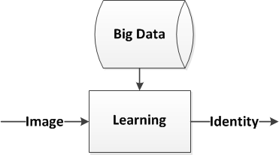
Deep Learning Pipeline

Slide 47
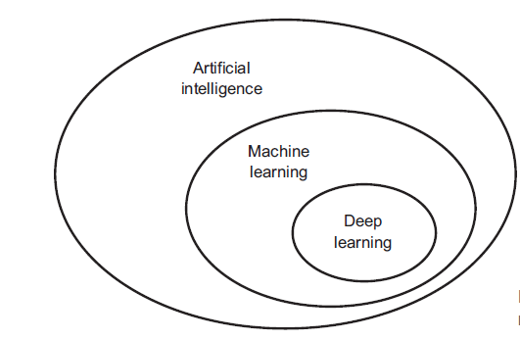
AI vs. ML vs. DL
Deep Learning with Python, Chollet

Slide 48
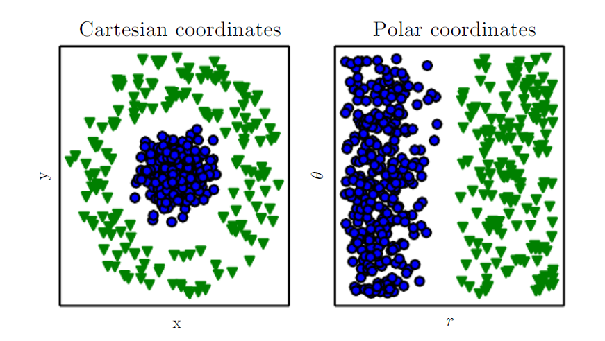
Why representation matters so much?
We have two categories (blue/green) which we want to cluster/separate/classify
So separating the two classes in this case is much easier just by using polar representation

Slide 49
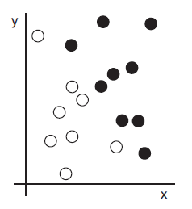
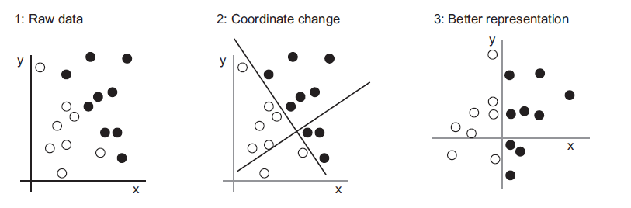
Why representation matters so much?
We want to develop an algorithm that can take
the coordinates (x, y) of a point and output whether that point is likely to be black or to be white:
Inputs: the coordinates of our points.
Outputs: the colors of our points.

Slide 50
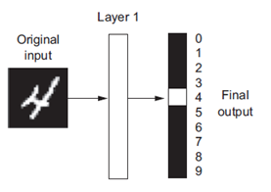
How to decide on which representation? Search problem
Manual: ML
Learning: DL
(Representation Learning)
What we look for? The best transformation function = model
Best to what? To represent data to get best results
How ?
Hypothesis space: We have many possible transforms: f1, f2,…
Learning: Search in the hypothesis space

Slide 51
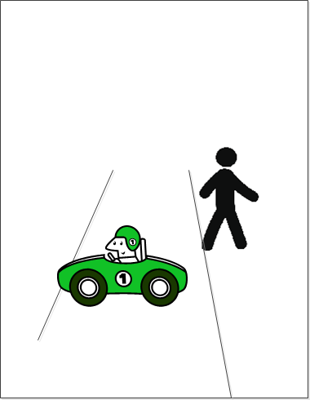
Puzzle Reconstruction
Notes:
The idea is simple, and can be described by a game.
Let’s make a puzzle out of this picture.

Slide 52
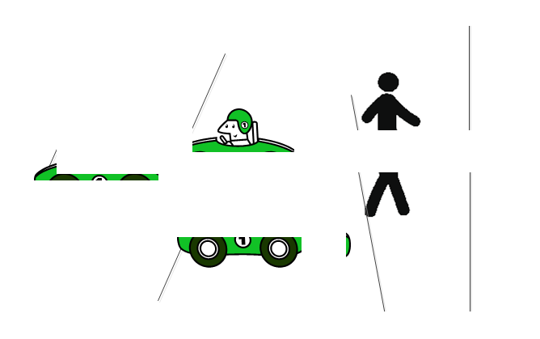
Puzzle Reconstruction
Notes:
Now let’s re-assemble it.

Slide 53
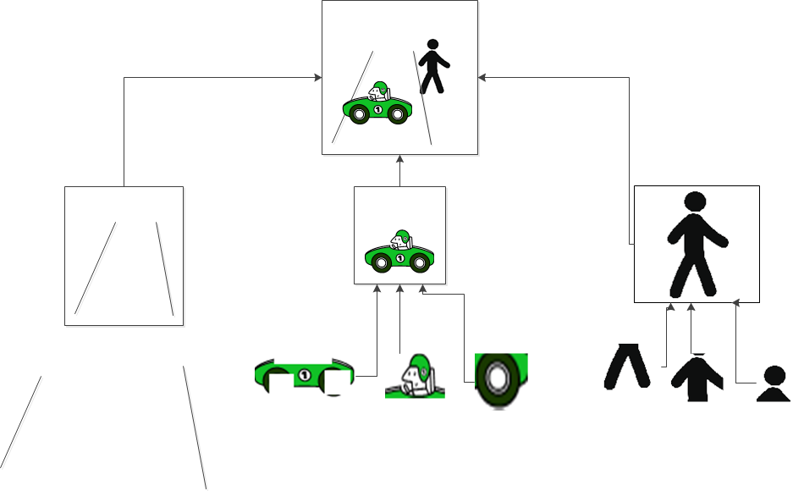
Deconstruction - Reconstruction
Notes:
To be able to reconstruct, the model must have a DB of components to select from them and form the shape.
Those components are identified during the deconstruction.
This DB is just the pieces in the puzzle box.
Those components are filters or features. The model searches for each of them in the input, if there’s a match, the component is included in the reconstruction.
In technical words, those components are the eigen or basis vectors of the input space→ like x and y in the cartesian coordinates, where all points in the 2D space can be formed from linear combinations of x and y basis vectors.
Those components are the common or average patterns that are repeated in most of images

Slide 54
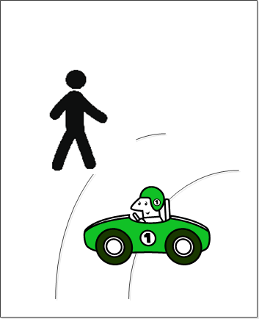
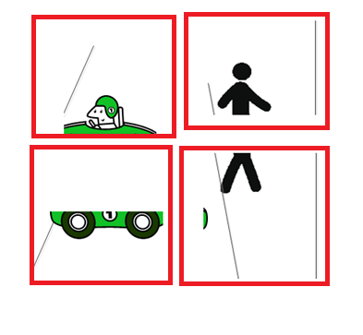

Generic puzzle?
Notes:
Now, what if we want to construct a different shape?
Well, the puzzle pieces are only designed for one picture.
Simply, they don’t contain the curved line pieces.

Slide 55


Generic puzzle?
Notes:
So if we want a 2-pictures puzzle, we need to have all the pieces.
But how far can keep in our DB?
Can we keep all the pieces of all the images?
The concept of re-use can be used as above.

Slide 56

Deconstruction - Reconstruction
Notes:
To be able to reconstruct different images, the DB should contain all kinds of templates (basis vectors) that enable reconstruction
This DB is updated with every new input

Slide 57







Generic re-usable units
Notes:
We can’t have huge DB of parts
The concept of re-use can be further extended to finer pieces = edges, of which more complicated pieces can be formed.
We have to come up with min. re-usable units → same as Lego → few units many shapess
Re-usable units = Representations = Weights
Same concept can be applied to SW arch.
It is said that using the same concept, the min. coherent and re-usable SW components can be identified by AI!

Slide 58

What is meant by “hierarchal representation”?
Deep learning summer school, Montreal, 2015: Convolutional NN, Lee
Notes:
Eigen faces, basis vectors, learnt from Big Data
Disassemble then assemble
Constrained optimization problem→ Min. Reconstruction Error, s.t.c. for all pictures
This is why eigen vectors are discovered
With the input data space getting larger, better natural basis vectors are discovered→ so it becomes eigen faces
The representations are discovering the composition of the input→ we will see why this happens
This composition is just the Alphabet of the task at hand
= The vocabulary in NLP and text
= The human parts anatomy
= The chemical components
= The alphabet in genomes
…..
Now the net knows:
1- To generate different shapes, there are certain common constructs it must learn first. This happens thanks to the concept of distributed representations which allows the network to re-use the representation in different layers. So the network knows that it has to learn edges for example because it has to combine them to generate squares, and curves to generate circles in the next layer and so on.
This is obtained from the data itself and hence unsupervised.
2- Then in each deeper layer, progressively the network learns how to combine the lower layers features.
Note the input layer features are called features detectors
3- At the top layer, abstraction reaches the application objective itself. This layer forms an associative memory of faces for example. The combinations of those faces are the network belief of all the faces in the world.
Note about network arch. Choice:
1st layer >> input to allow different features extraction like SIFT detectors. This layer is called features detectors and act like the eye receptive fields
- Next layers of equal size (heuristic)
Stop in depth when visualization (if possible) gives the task objective. For example faces.
4- All this learning comes from the generative objective only. No supervision. Just learning from data.
Side note:
Generation or sampling from the model belief happens by adding a top layer of N-neurons = number of faces we have, then to generate, we just force all to 0 and let only = 1, then feed backward this top layer hot vector to the input and visualize what we get. Remember, this is undirected graph as we will see, so we can feed in both fwd and backwrd directions.

Slide 59


The “Deep” in Deep Learning Hierarichal Representation

Slide 60
Now we converge to a definition of Deep Learning
Deep Learning = Deep Representation Learning
“Deep learning is a particular kind of machine learning that achieves great power and flexibility by learning to represent the world as a nested hierarchy of concepts, with each concept defined in relation to simpler concepts, and more abstract representations computed in terms of less abstract ones.”
Deep Learning Book, Ian Goodfellow, Yoshua Bengio, Aaron Courville

Slide 61

Now we can draw a line between AI, ML, Representation Learning and DL “Deep Learning Book”

Slide 62
Types of ML How we learn the representation(=model)?
Machine Learning
Unsupervised
Reinforcement Learning
(RL)
Supervised

Slide 63

How it works? Supervised with a teacher

Slide 64

How it works? Unsupervised from big data
Notes:
Self learning machines.
Clustering is possible.
Between the lines + Flat→ Class A
Outside + Tall → Class B
Don’t know yet what are the names of the classes or what they represent
Therefore, good features could be the road curves + flat and tall bounding boxes in the specified areas

Slide 65




How it works? By interaction (Reinforcement)
Learning in mammals
After many attempts

Slide 66


How it works? Supervised
Network of Artificial Neurons (Brain)
Group of neurons can be thought of as filters
Each needs to trigger/fire with different stimulus input (Example)
Obtained == Desired?
Adjust ALL parameters/neurons
Traditional way, these filters are designed not learnt.
Can you design all possible patterns?
Feed tons of labeled images

Slide 67
How DL works? Ingredients
Model: function mapping:
X = fw(Y), w=1,2,…etc,
Data:
X, Y (supervised)
Loss:
How good Model fits Data?
Optimizer:
search for best fw, that makes the Model fits the Data with min. Loss.

Slide 68

How DL works? 1. Model

Slide 69

How DL works? 2. Data

Slide 70

How DL works? 3. Loss 4. Optimizer
Optimizer does the “search”
Using backpropagation

Slide 71
Which AI problems DL is solving?
Perception
One-one mapping: Associative→ reactive mode
No integration of information, no sequence of events
Ex: traffic sign recognition
Prediction
Many-one, Many-Many mapping, memory mode
Requires integration of info over time, build pdf of belief
Ex: predict driving actions, mapping,..etc
Planning/
Control
Many-one relations + adaptation of planning actions, planning mode
Requires integration over time + future planning to choose the best set of actions
Ex: autonomous driving (age of driving license eligibility)
Recognize static objects
Track dynamic objects
Plan actions in dynamic environment
Notes:
Until Geoff. Hinton (the father of ANN also) in 2006 in Toronto invented the DBN → Wave 1.
The idea is to cluster the data, and discover their eigen vectors. Same as Lego building blocks, so it tries to discover those blocks. For each picture in the Lego manual, it is characterized by what are the building blocks (features ) it uses ((extraction)) from the box = features (extraction)
This was followed by another wave of introducing the time factor ➔ composition learning and recurrent NN
This was followed by another wave of higher level intelligence → DL + RL

Slide 72
How DL address those levels
Perception
DNN/CNN
Prediction
RNN
Planning/
Control
DRL, Imitation
Notes:
Recognition
Until Geoff. Hinton (the father of ANN also) in 2006 in Toronto invented the DBN → Wave 1.
The idea is to cluster the data, and discover their eigen vectors. Same as Lego building blocks, so it tries to discover those blocks. For each picture in the Lego manual, it is characterized by what are the building blocks (features ) it uses ((extraction)) from the box = features (extraction)
DNN/CNN
Prediction
This was followed by another wave of introducing the time factor ➔ composition learning and recurrent NN
RNN/RAE/RNTN
Planning
This was followed by another wave of higher level intelligence → DL + RL
RL, DQN, DRQN, DARQN

Slide 73

Third Pillar: Deep learning with GPU

Slide 74

Deep learning with GPU – CUDA / OpenCL
Alternative = OpenCL → You need to write your own HW GPU driver
NVIDIA presentation: introduction to deep learning with GPU, http://on-demand.gputechconf.com/gtc/2015/webinar/ deep-learning-course/intro-to-deep-learning.pdf
Notes:
NVIDIA DRIVE PX platform (http://www.nvidia.com/object/drive-px.html) (http://techno-stream.net/drive-px-mimics-brain-with-deep-learning/)
The application is written on top
But for the time being, the practical use case is that the whole stack can be modified by the developer/researcher. Specially the DL framwork (the one before the last)

Slide 75
Deep learning with GPU
Frameworks
Keras
TF
Pytorch
CNTK (MicroSoft)

Slide 76
Conclusion
AI vs. ML vs. DL
Representation learning
Learning modes
Types of DNN for different AI problems
Deep learning on GPUs
Take Away Message

Slide 77

Questions

